Slide 1
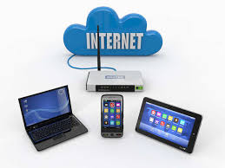
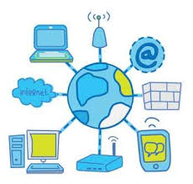

Internet & Networking

Slide 2
Introduction
We already aware about the term INTERNET why bcs nowadays without internet our mobile or other activities may get struck up. Why ?
To phone call , E- mail, Watsapp, Facebook, Instagram all work with using Internet only other than that E- Commerce like Banking, Ticket booking, Job applying , Trading, etc dependence on the internet.

Slide 3
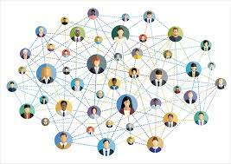
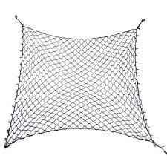
Network Concept

Slide 4
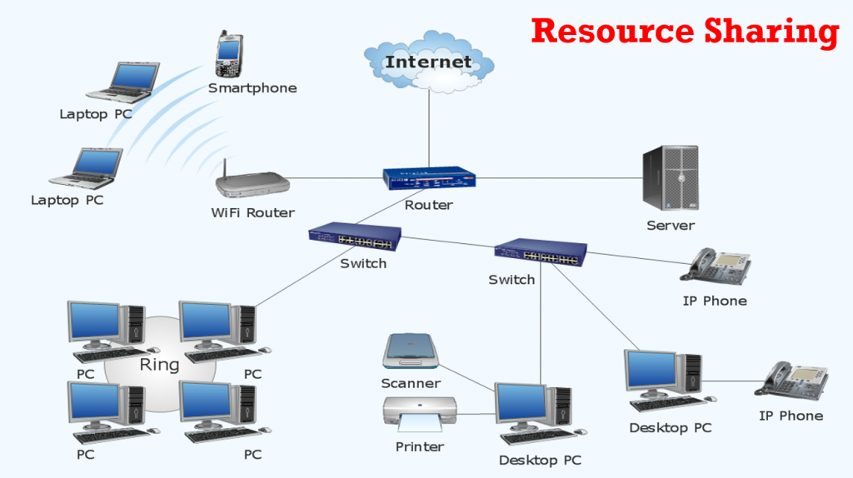
Network Concept

Slide 5
Network Concept

Slide 6
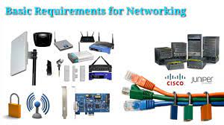
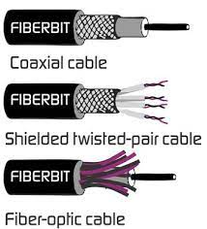
Network Concept

Slide 7
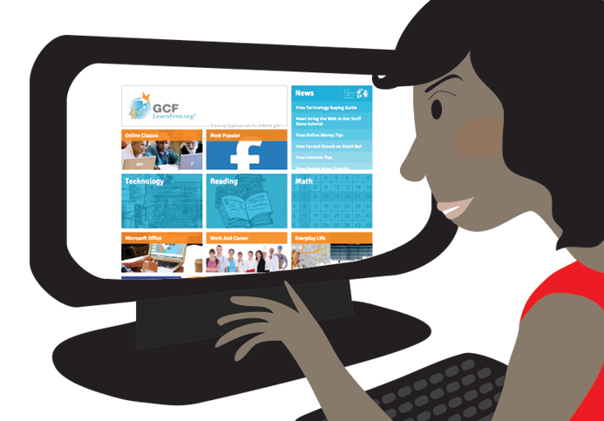
What Is Network
A network consists of two or more computers that are linked together to share information with the help of networking medias like modem, switches , routers, ISP etc

Slide 8
Types of Network
LAN (Local Area Network)
MAN (Metropolitan Area Network)
WAN (Wide Area Network)

Slide 9
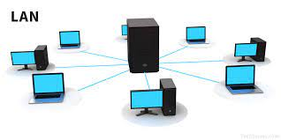
LAN (Local Area Network)
A local area network (LAN) is a connection of devices connected together in one physical location, such as a building, office, or home.

Slide 10
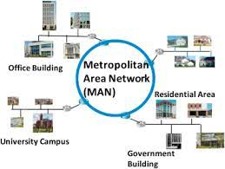
MAN (Metropolitan Area Network)
A metropolitan area network (MAN) connects computers within a metropolitan area, which could be a single large city, multiple cities and towns, or any given large area with multiple buildings

Slide 11
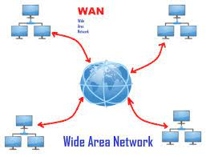
WAN (Wide Area Network)
A wide area network (WAN) is a computer network that covers a large geographical area comprising a region, a country, a continent or even the whole world

Slide 12
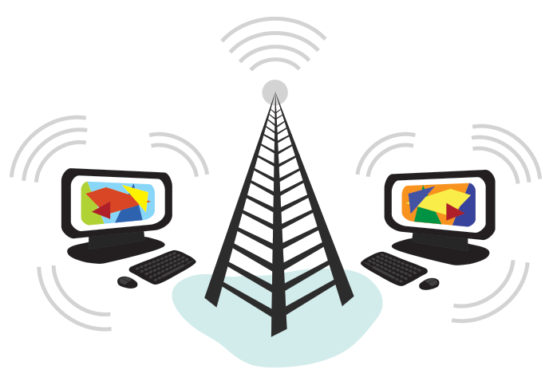
What is Internet
Internet is an inter connection between millions of computers to exchange data like text, images, files etc.
The internet is actually a network of networks that connects billions of digital devices worldwide.

Slide 13
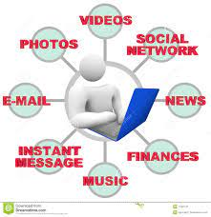
Advantages of internet
Financial services. Email.
Web-enabled audio/video conferencing services.
Online movies and gaming.
Data transfer/file-sharing, often through File Transfer Protocol (FTP).
Instant messaging.
Internet forums.
Social networking.
Online shopping.

Slide 14
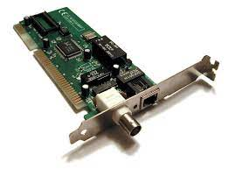
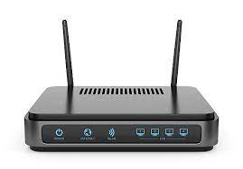
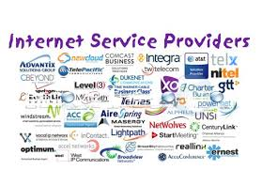



Requirements of internet
Computer
Network card
Modem and Telephone line
ISP (Internet Service Provider) Ex : BSNL, Airtel, Jio, VI etc
Web Browser – application

Slide 15
Terms of internet
WWW – World Wide Web
HTTP – Hyper Text Transfer Protocol FTP – File Transfer Protocol
IP- Internet Protocol
Website
Web page
HTML – Hyper text Markup Language
Home Page
URL – Uniform Resource Locator – Unique Address of each webpage
Domain Name ( .com , .org, .in. Etc)
* Host Name

Slide 16
WWW – World Wide Web : The World Wide Web is a computer system which links documents and pictures into a database that is stored in computers in many different parts of the world and that people everywhere can use. The abbreviations WWW and the Web are often used.
HTTP – Hyper Text Transfer Protocol : HTTP is a way of formatting and transmitting messages on the internet. HTTP is an abbreviation for 'hypertext transfer protocol’.
FTP – File Transfer Protocol - file transfer protocol; the standard protocol used to transfer files across the internet, or a similar network, between computer systems
IP- Internet Protocol:- internet protocol: a code used to label packets of data sent across the internet, identifying both the sending and the receiving computers
Website - A website is a set of data and information about a particular subject which is available on the internet.
website is a collection of many web pages, and web pages are digital files that are written using HTML(HyperText Markup Language).

Slide 17
Web page :
A web page or webpage is a document, commonly written in HTML, that is viewed in an Internet browser. A web page can be accessed by entering a URL address into a browser's address bar. A web page may contain text, graphics, and hyperlinks to other web pages and files.
HTML – Hyper text Markup Language:- HTML stands for HyperText Markup Language. It is a standard markup language for web page creation. It allows the creation and structure of sections, paragraphs, and links using HTML elements (the building blocks of a web page) such as tags and attributes.
HTML has a lot of use cases, namely:
Web development. Developers use HTML code to design how a browser displays web page elements, such as text, hyperlinks, and media files.
Internet navigation. Users can easily navigate and insert links between related pages and websites as HTML is heavily used to embed hyperlinks.
Web documentation. HTML makes it possible to organize and format documents, similarly to Microsoft Word
Home Page :
A home page is the default or front page of a site. It is the first page that visitors see when they load a URL. Web managers can control the home page as a way of directing the user experience.

Slide 18
URL – Uniform Resource Locator – Unique Address of each webpage - A Uniform Resource Locator (URL), colloquially termed as a web address,^{[1]} is a reference to a web resource that specifies its location on a computer network and a mechanism for retrieving it.
Domain Name : When referring to an Internet address or name, a domain or domain name is the location of a website. For example, the domain name "google.com" points to the IP address "216.58.216.164". Generally, it's easier to remember a name rather than a long string of numbers. A domain name contains a maximum of sixty three characters, with one character minimum, and is entered after the protocol in the URL, as shown in the following example.
the most common top-level domains are .com, .net, and .org. Originally, each had a unique purpose:
.com: Commercial (for-profit) websites
.net: Network-related domains
.org: Non-profit organizations

Slide 19
internet Surfing
E-Mail
E- Commerce
Searching of Information
Downloading Images, Audio, Video etc
Watching Movies
Ordering Products
Banking Logins
Email and Watsapp
Chatting
Software Downloading

Slide 20
E-Mail Creation
Go to Google
Click on Gmail at right side of the page
Select Create New option
Fill the form as requirement to create page
Click on Next / submit

Slide 21
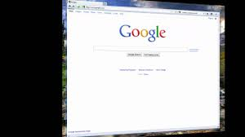
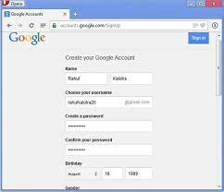
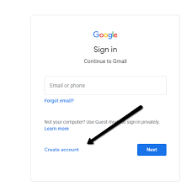
E-Mail Creation

Slide 22
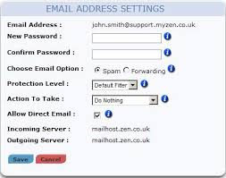
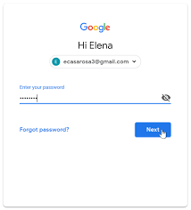

Slide 23
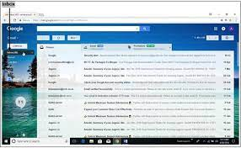

Slide 24
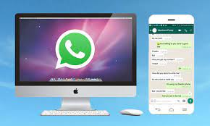
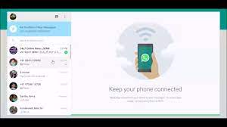
WATSAPP CONNECT TO pc

Slide 25
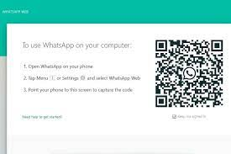
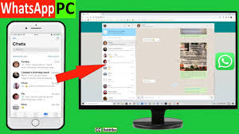

Slide 26
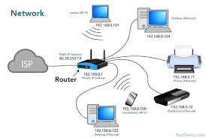
Thank you

